Slide 1
Chongqing University of Technology
ATAI
Advanced Technique of Artificial Intelligence
Chongqing University of Technology
Personalized News Recommendation with
Knowledge-aware Interactive Matching
（SIGIR-2021)
Reported by Jia Wang
Notes:
交互式匹配的个性化新闻推荐

Slide 2
Chongqing University of Technology
ATAI
Advanced Technique of Artificial Intelligence
Chongqing University of Technology
1. Introduction
2. Approach
3. Experiments
4. Conclusion

Slide 3
Introduction
First： a candidate news may cover different aspects and entities, and a user may have multiple interests.
Second： the matching between user interest and candidate news is usually implied in the matching between texts of clicked news and candidate news.
Third：with the help of the knowledge graph, the matching between entities in clicked news and candidate news is also informative for understanding user interest in candidate news.
Notes:
大多数现有的新闻推荐方法通常都是根据其文本内容来模拟候选新闻，并根据其点击的新闻来模拟用户的兴趣。但是，新闻文章可能涵盖多个方面和实体，并且用户可能有多个兴趣。对候选新闻和用户兴趣的独立建模可能会导致新闻与用户之间的较差的匹配

Slide 4
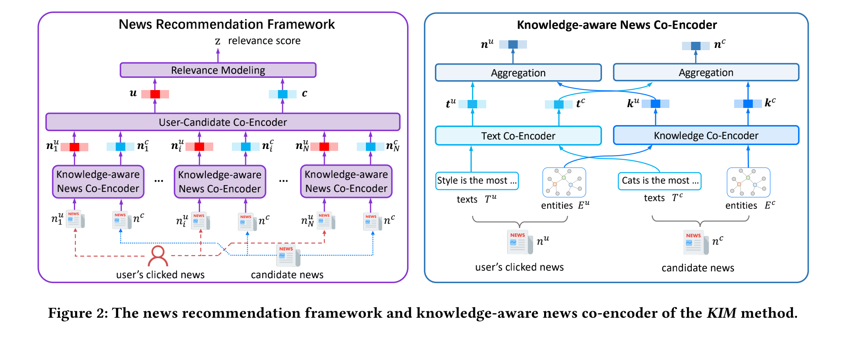
Approach

Slide 5
Approach

Slide 6
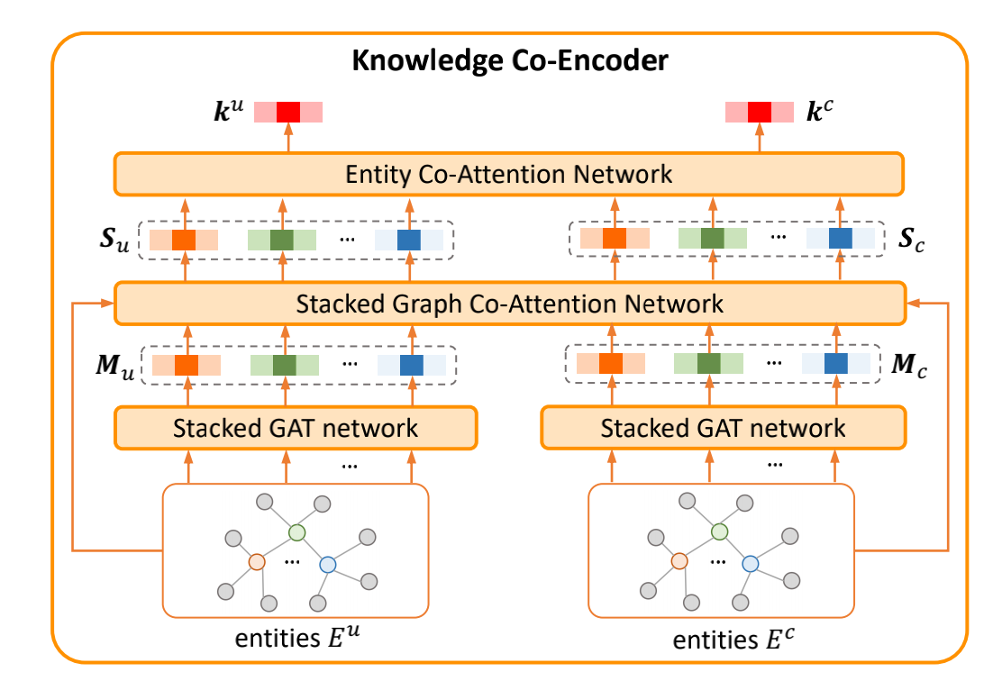
Approach

Slide 7
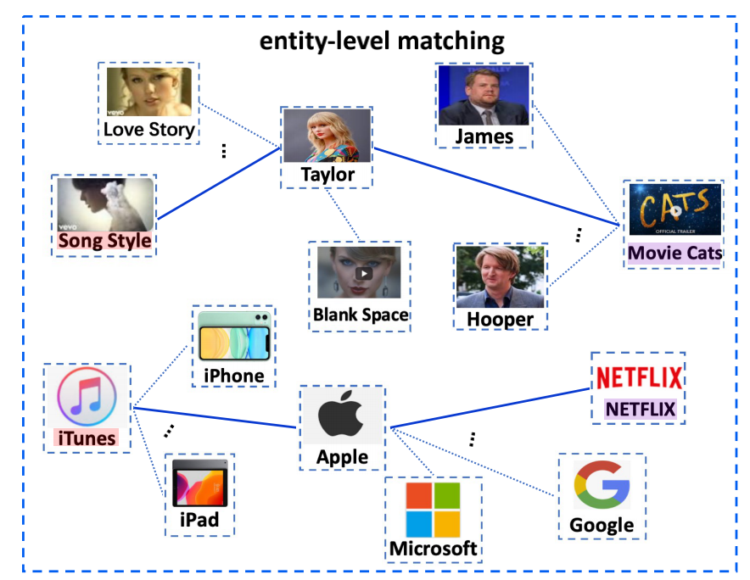
Approach

Slide 8
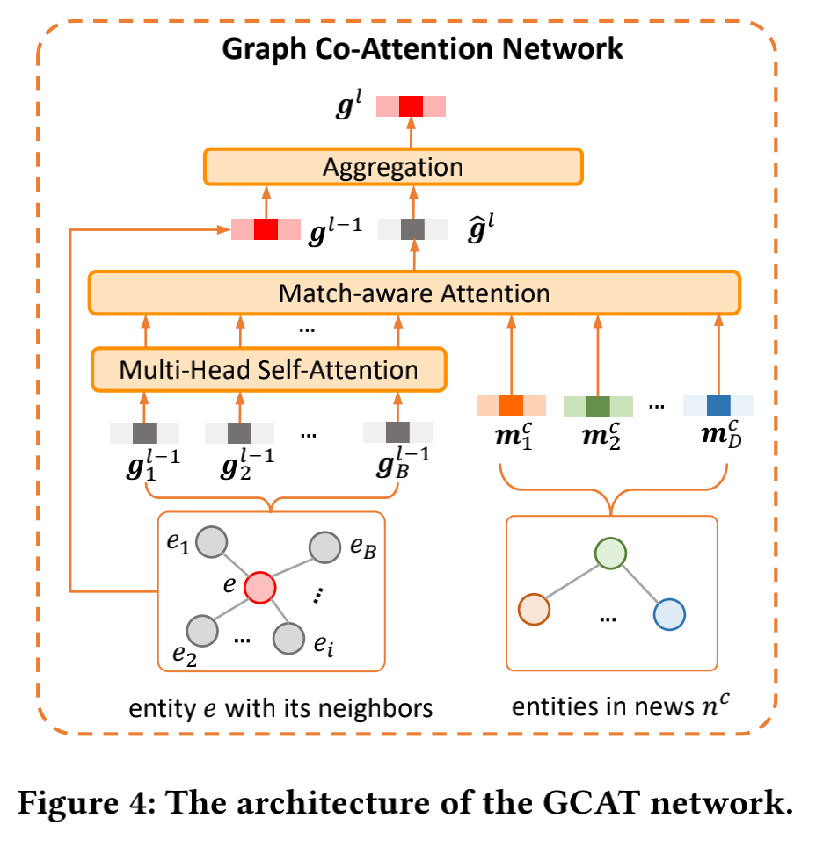
Approach

Slide 9
Approach

Slide 10
Approach

Slide 11
Approach

Slide 12
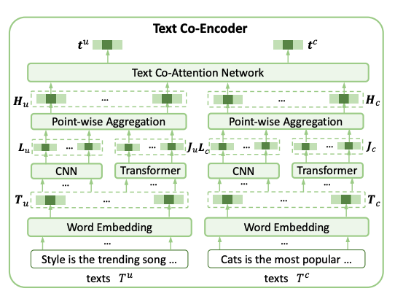
Approach

Slide 13
Approach

Slide 14
Approach

Slide 15
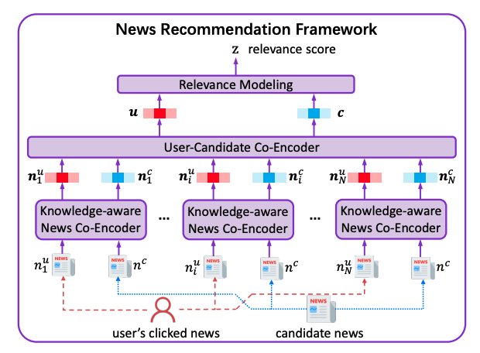
Approach

Slide 16
Approach

Slide 17
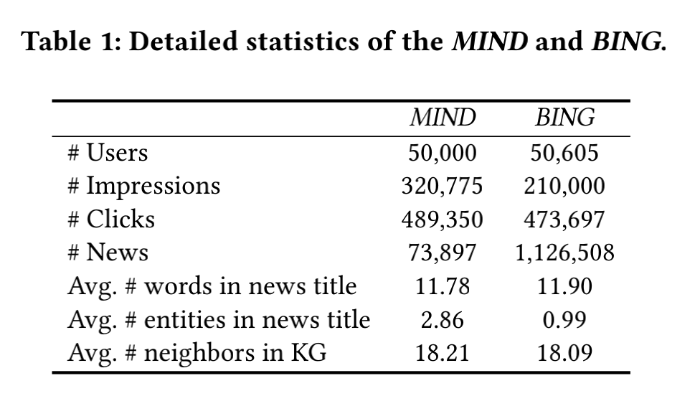
Experiments

Slide 18
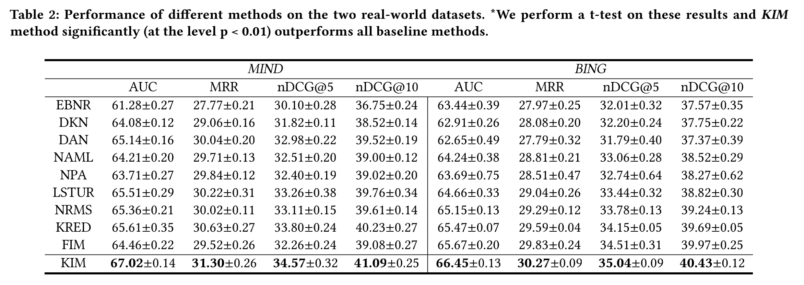
Experiments

Slide 19
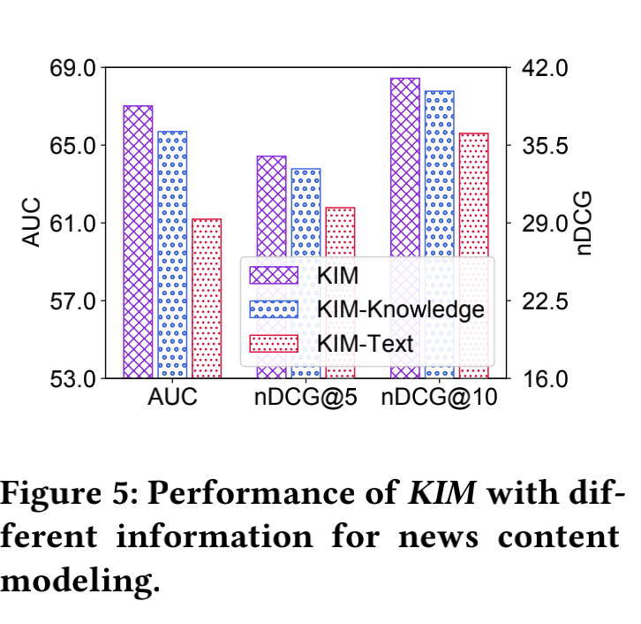
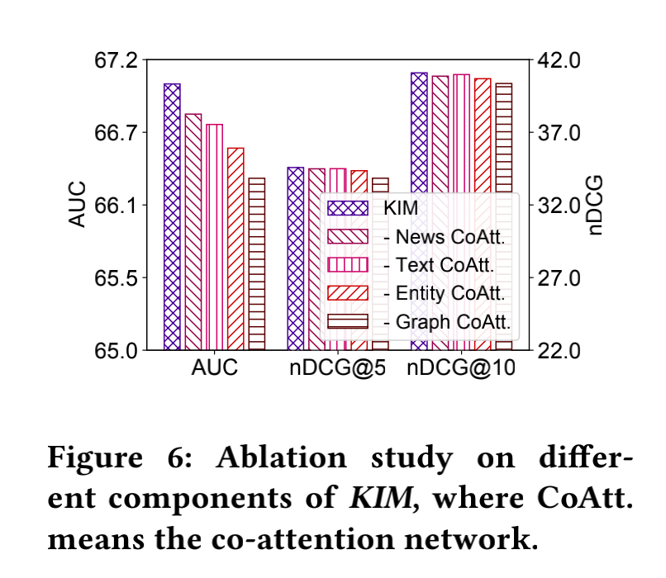
Experiments

Slide 20
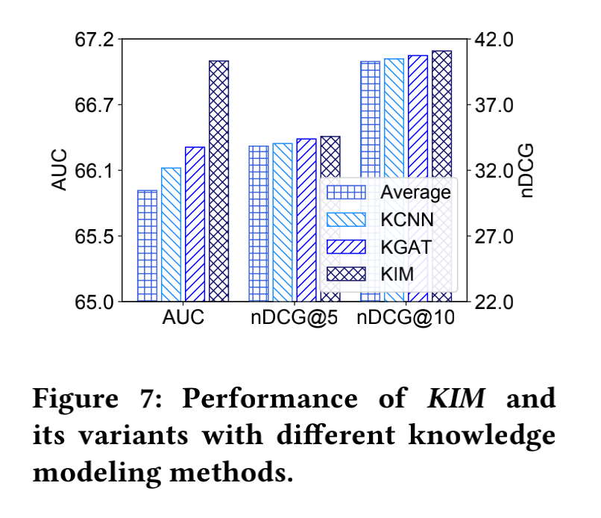
Experiments

Slide 21
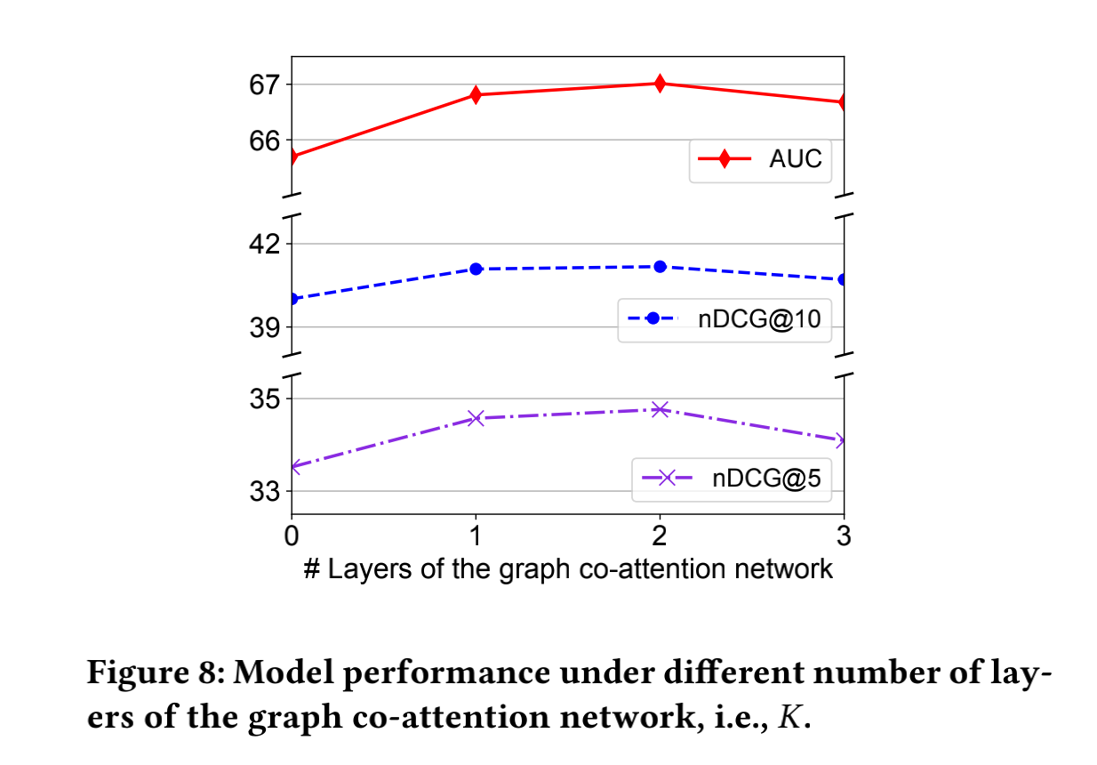
Experiments

Slide 22
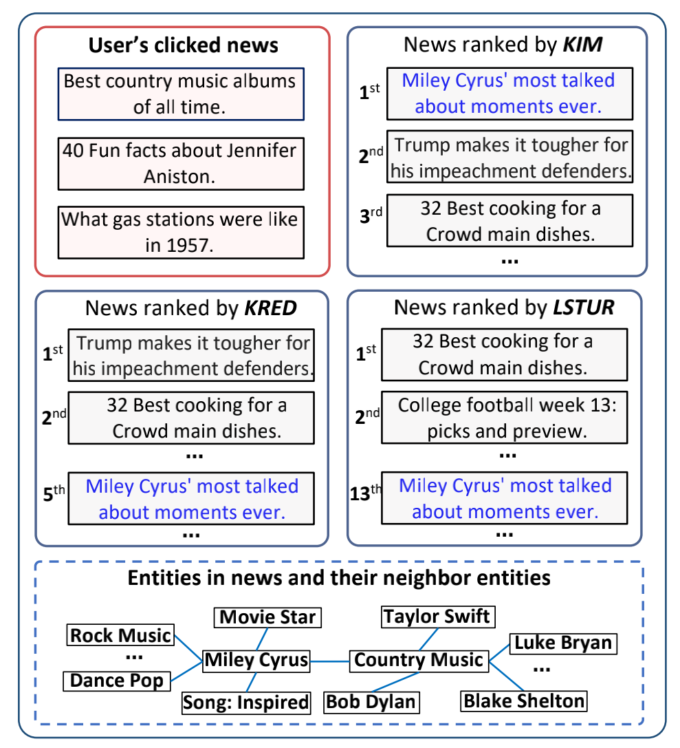
Experiments

Slide 23
Conclusion
In this paper, we propose a knowledge-aware interactive matching framework for personalized news recommendation (named KIM).The framework aims to interactively model candidate news and user interests for more accurate interest matching. More specifically, we first propose a graph co-attention network to model entities based on the knowledge graph by selecting and aggregat_x0002_ing the information of their neighbors which are informative for interest matching. We also propose to use an entity co-attention network to interactively model clicked news and candidate news from relatedness between their entities. Besides, we propose to use a text co-attention network to interactively model clicked news and candidate news from semantic relatedness between their texts. Moreover, we propose a user-candidate co-encoder to learn candi_x0002_date news-aware user representation and user-aware candidate news representation to better capture the relevance between user interest and candidate news. We conduct extensive experiments on two real-world datasets. The experimental results show that our KIM method can significantly outperform other baseline methods.

Slide 24
Thanks

